Slide 1
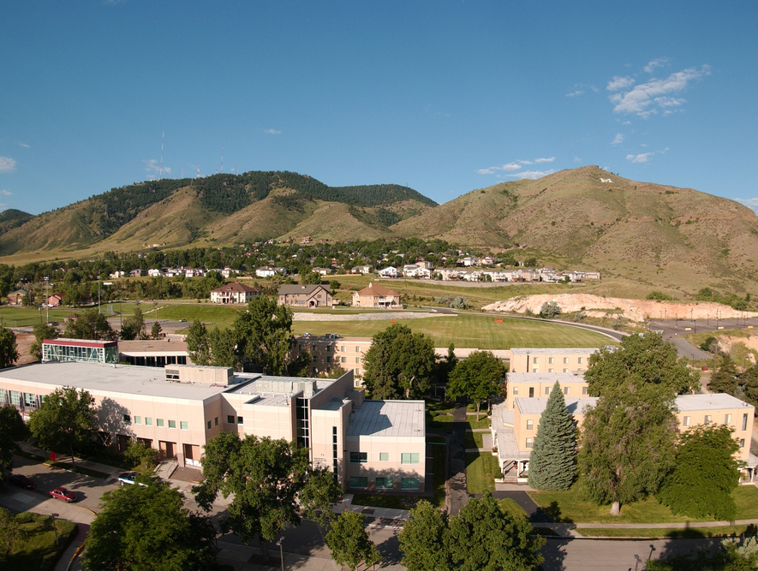
Colorado School of Mines
Computer Vision
Professor William Hoff
Dept &Computer Science
http://inside.mines.edu/~whoff/

Slide 2
Image Stitching

Slide 3
Image Stitching
Take a collection of images, align them, and stitch them into a seamless photomosaic
Steps:
Find the transforms relating pairs of images
E.g., homography transforms
Choose a compositing surface to display the mosaic on
E.g., a plane or cylinder
Align the images and blend them
Remove unwanted objects (such as moving objects)
Compensate for exposure differences
Smooth the seams between images

Slide 4
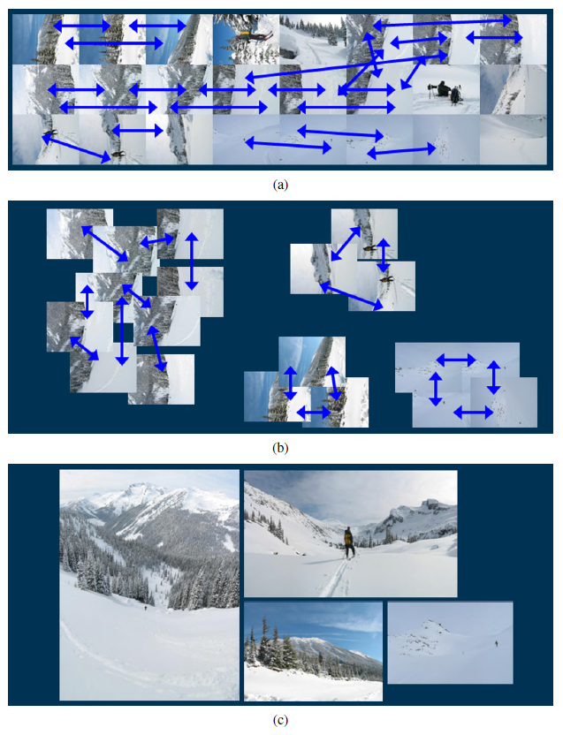
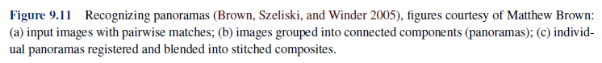
From Szeliski, Computer Vision: Algorithms and Applications

Slide 5
Simple Stitching Algorithm
Assume:
Input is a sequence of images
Each image overlaps with the ones adjacent to it in the sequence
Use a plane for the compositing surface
Each subsequent image is aligned to the previous image, using a homography
Warp the images to the mosaic frame, and blend it with the mosaic image by simple averaging

Slide 6
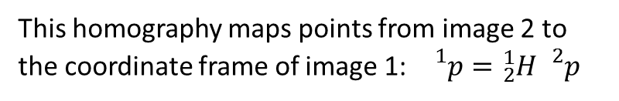
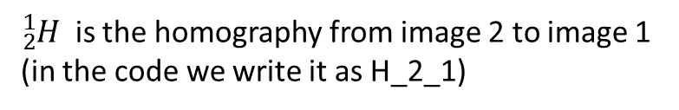
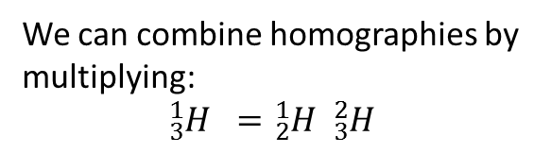
Combining Homographies
${}_{2}^{1}{H }$ is the homography from image 2 to image 1 (in the code we write it as H_2_1)
1
2
This homography maps points from image 2 to the coordinate frame of image 1: ${}_{}^{1}p={}_{2}^{1}{H {}_{}^{2}p}$
1
We can combine homographies by multiplying:
$${}_{3}^{1}{H }={}_{2}^{1}{H {}_{3}^{2}{H }}$$
2
3

Slide 7
Pseudocode
Get the first image -> Icurrent
Compute H_current_mosaic Compute the homography from the 1st image to the mosaic
Iprev = Icurrent Initialize the “previous” image for the loop below
H_prev_mosaic = H_current_mosaic
Repeat until no more images
Get the next image -> Icurrent Get the next image in the sequence
Compute H_current_prev Compute the homography from the current to the previous image
H_current_mosaic = H_prev_mosaic * H_current_prev
Warp Icurrent using H_current_mosaic, to get Icurrent_warp Align current image to mosaic
Imosaic = blend(Imosaic, Icurrent_warp)
Iprev = Icurrent The current image becomes the previous image, for the next iteration
H_prev_mosaic = H_current_mosaic
end

Slide 8
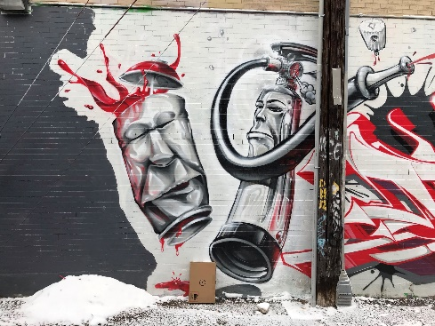
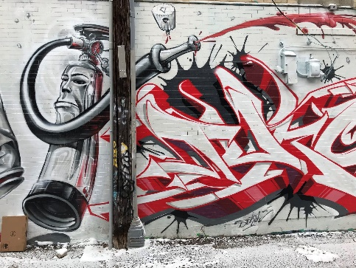
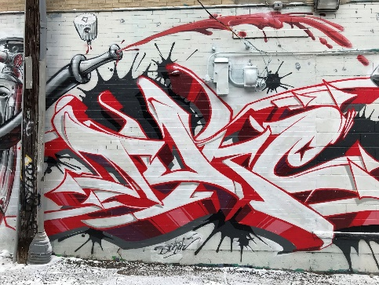
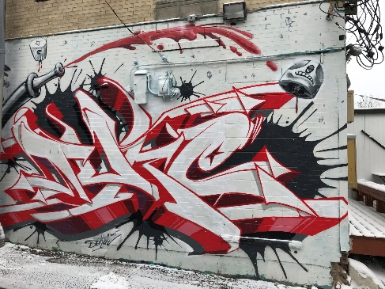
Demo
wall1.jpg
wall2.jpg
wall3.jpg
wall4.jpg
This box is 0.335 meters wide x 0.495 meters high
Pick the size and scale of the output mosaic (orthophoto)
Scale: 1 pixel = 1 cm
Size: 1500x700 pixels
Pick the location of the box in the output image
offset_x_pixels = 300
offset_y_pixels = 500

Slide 9
Mosaic construction
1500
Box corners (x,y):
(300,500)
(333.5, 500)
(333.5, 549.5)
(300, 549.5)
500
700
300
Box is 33.5 pixels wide x 49.5 pixels high

Slide 10
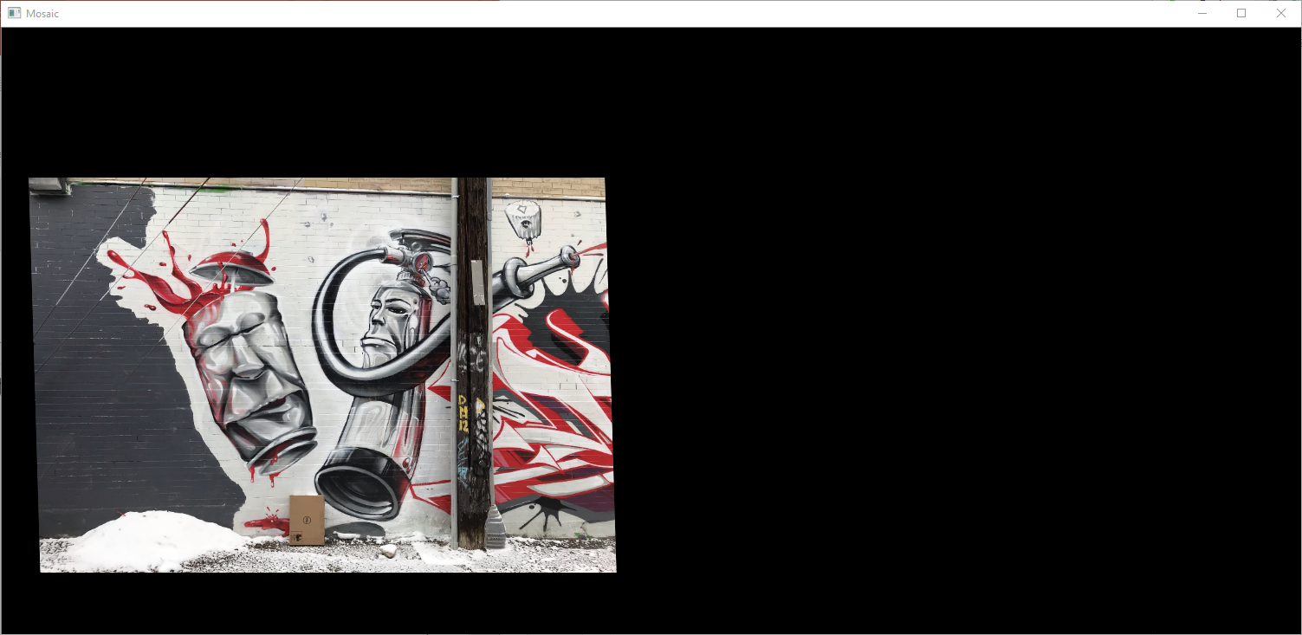
Mosaic construction
After warping 1st image to the mosaic frame

Slide 11
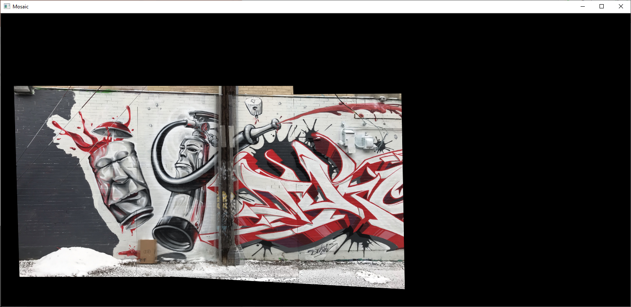
Mosaic construction
After warping 2nd image to the mosaic frame, and blending it with the mosaic

Slide 12
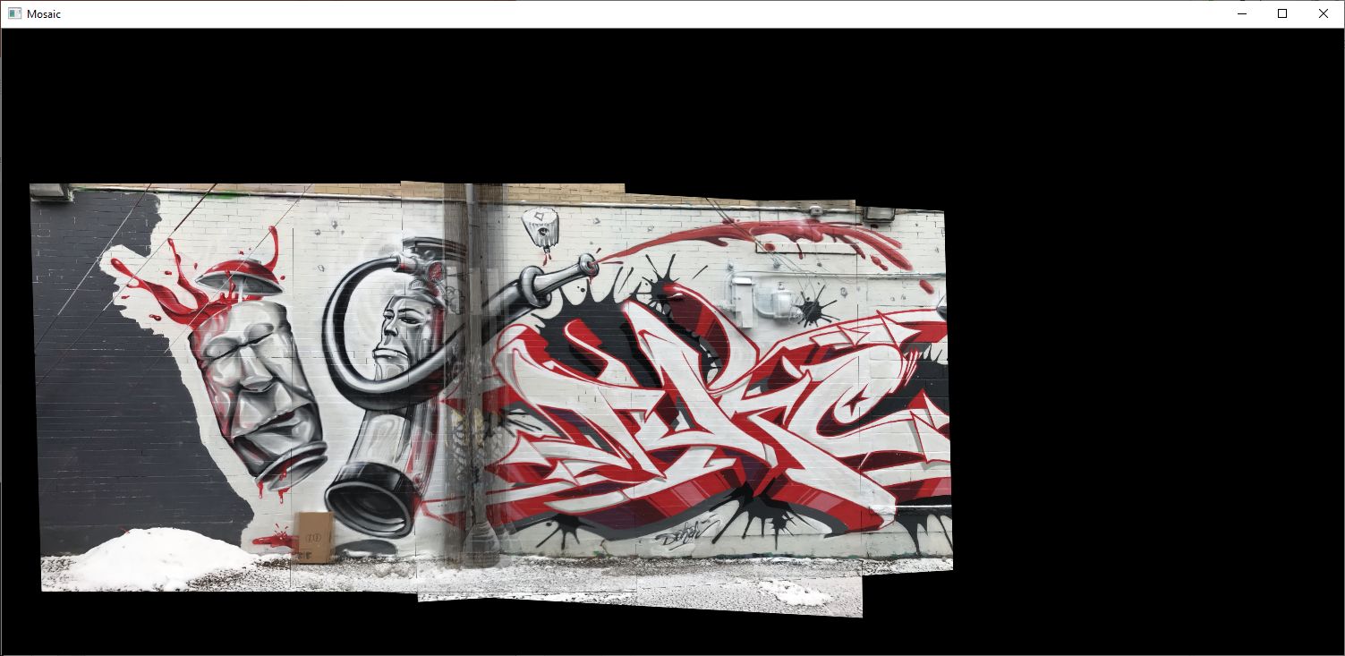
Mosaic construction
After warping 3rd image to the mosaic frame, and blending it with the mosaic

Slide 13
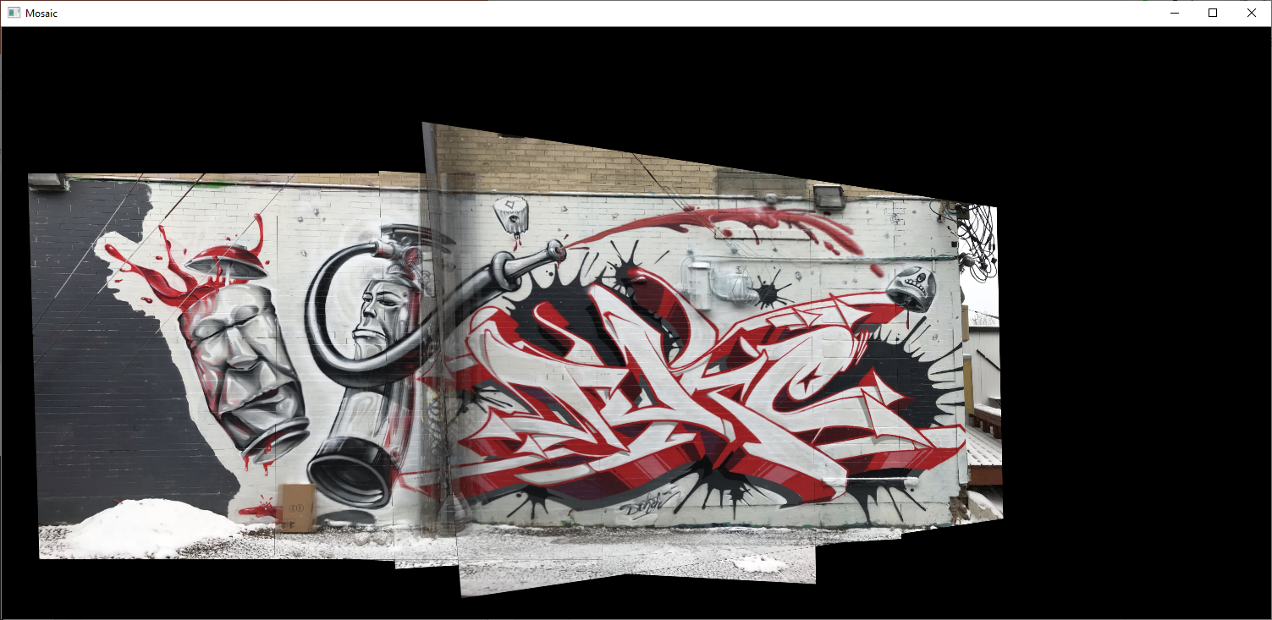
Mosaic construction – final result
After warping 4th image to the mosaic frame, and blending it with the mosaic

